Slide 1
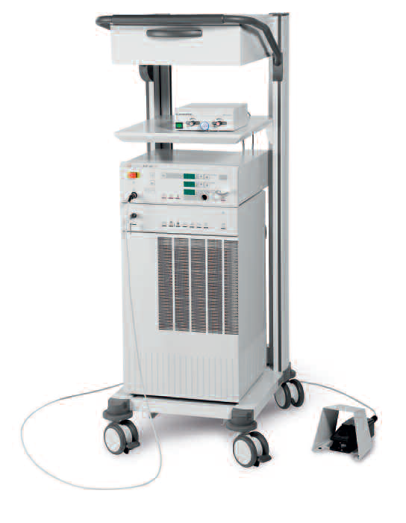
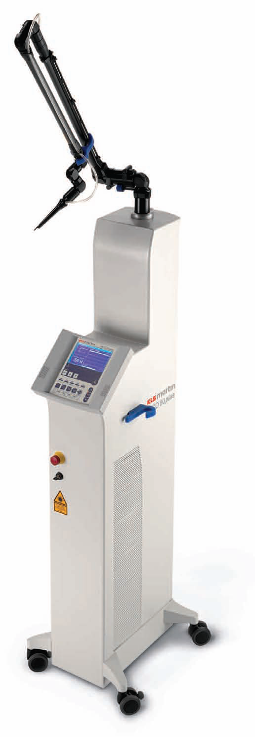
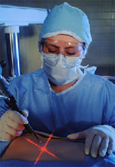
MEDICAL LASER SYSTEMS
Assist Prof. Dr. Lutfi Ghulam Awazli
Institute of laser for postgraduate studies
University of Baghdad

Slide 2
Laser-Induced Interstitial Thermotherapy (LITT)

Slide 3
Laser-Induced Interstitial Thermotherapy (LITT)
What is LITT ?
Is a minimally invasive therapy for the treatment of solid tumors (breast tumors, liver tumors, brain tumors, thyroid nodules, prostate, kidney, bone ,spine, so on… ) that uses laser light to destroy the diseased tissue through heat (localized tissue coagulation).
The principal idea of LITT:
The principal idea is to position an appropriate laser applicator inside the tissue to be coagulated, e.g. a tumor, and to achieve necrosis by heating cells above 60◦C. ( denaturation of proteins and coagulation occur at these temperatures). Due to the associated coagulation of blood vessels, severe hemorrhages are less likely to occur than in conventional surgery. This is of particular importance in the case of tumors, because they usually are highly vascularized.
Either Nd:YAG lasers at 1064nm or different types of diode lasers at 800–900nm are applied, since light deeply penetrates into tissue at these wavelengths. Thus, large volumes can be treated with temperature gradients based mainly on heat conduction . Typical parameters of the procedure are 1–5W of CW laser power for a period of several minutes and coagulation volumes with diameters of up to 40 mm.

Slide 4
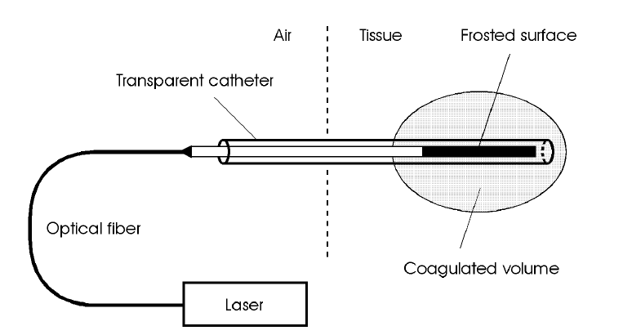
Laser-Induced Interstitial Thermotherapy (LITT)
Fig. 3.23. Experimental setup for laser-induced interstitial thermotherapy. Laser radiation is applied to the tissue through an optical fiber. The fiber is placed inside the tissue by means of a specially designed, transparent catheter. Tissue necrosis occurs in selected coagulated volumes only .

Slide 5
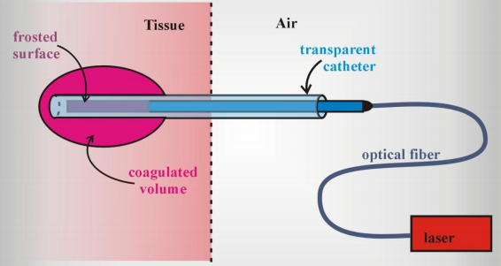
Laser-Induced Interstitial Thermotherapy (LITT)
Fig. 3.23. Experimental setup for laser-induced interstitial thermotherapy. Laser radiation is applied to the tissue through an optical fiber. The fiber is placed inside the tissue by means of a specially designed, transparent catheter. Tissue necrosis occurs in selected coagulated volumes only .

Slide 6
Procedure of LITT :-
The basic setup for LITT is illustrated in Fig. 3.23. The laser applicator usually consists of a flexible fiber and a transparent catheter through which the fiber is moved into the tissue.
In LITT, fiber optics are placed directly into the tumor to deliver laser light energy within the desired region of treatment.
Laser applicators for LITT may be inserted into target tissue using a number of image-guided techniques including x-ray, fluoroscopy, ultrasound , or MRI .
MRI in particular, is attractive because dynamic MRI can be used to evaluate temperature changes and/or tissue changes (vascularity, necrosis) as a potential means of feedback during the procedure.
After proper positioning of fibers, target tissues are irradiated using infrared laser. Either Nd:YAG lasers at 1064nm or different types of diode lasers at 800–900nm .
Absorption of light energy by the tissue volume results in volumetric heating which ultimately leads to thermal destruction of the tumor without affect the healthy tissue (i.e. pathological cells die, and healthy cells survive).
In order to achieve a safe LITT procedure, knowledge of the final damage zone is essential. Especially in neurosurgery, it is very important to prevent injury to adjacent healthy tissue and sensitive structures. The spatial extent of the damage zone primarily depends on laser power, laser exposure time, geometry of the laser applicator, and on thermal and optical tissue properties.

Slide 7
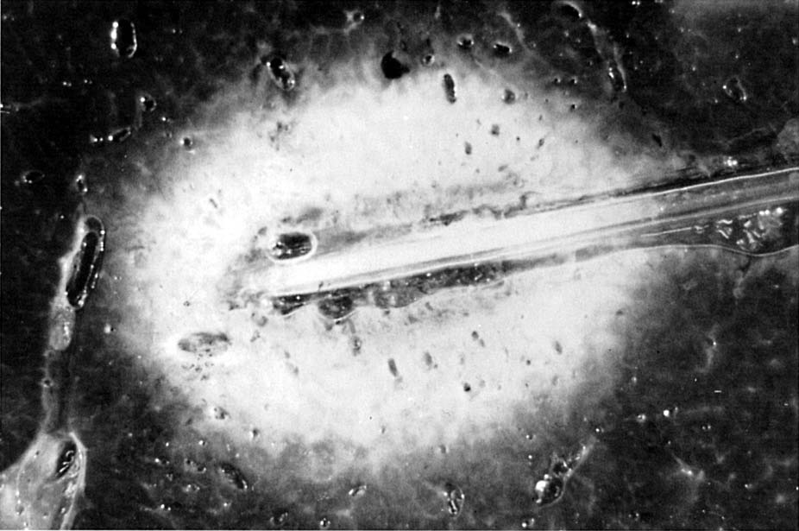
Fig. 3.26. Liver tissue after exposure to a Nd:YAG laser, using a standard LITT
fiber applicator (laser power: 5.5W, exposure duration: 10 min). The coagulated
volume visibly pales. Photograph kindly provided by Dr. Roggan (Berlin)

Slide 8
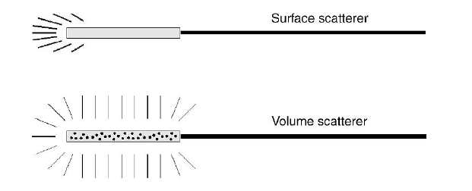
In general, two kinds of LITT applicators are distinguished:
(Surface scatterers and Volume scatterers ).
In Surface scatterers, light is scattered only at the very anterior surface of the applicator leading to a less homogeneous scattering (profile as shown in Fig. 3.29).
In Volume scatterers, light is scattered by tiny scattering centers distributed throughout the whole volume of the applicator.
Fig. 3.29. Scattering profiles of surface scatterer and volume scatterer, respectively

Slide 9
LITT have several advantages over standard surgical tools:-
1- It is minimally invasive: The laser probe is very thin ( less than 2mm in diameter).
The access smaller than typically created during a biopsy.
2- Can be performed with patient wide awake. Causes little or no pain during or after procedure .Recovery times, hospital stays, and complications are reduced due to the minimally invasive nature of the procedure. Entry site heals quickly with minimal scarring.
3- Due to the associated coagulation of blood vessels, severe hemorrhages are less likely to occur than in conventional surgery. This is of particular importance in the case of tumors, because they usually are highly vascularized.
4- The small size of the applicator enables safe access to deep seated and surgically inoperable tumors.
5- A particular advantage of LITT is that large amounts of energy delivered through small, flexible optical fibers and applied directly to the tumor rather than passing through surrounding normal tissue.
6- Also it heats the tumor from the inside and the energy deposition is more likely to be extended throughout the entire tumor.
7- Because LITT procedures are guided by MRI images, the procedure can be more precise than conventional surgery. So minimizing tumor recurrence and enhancing safety near critical structures during ablation of tumors
8- Because the LITT procedure delivers no (ionizing) radiation, the procedure can be repeated multiple times.
9- does not interfere with or disrupt or limit use of other treatment options.

Slide 10
Laser Ablation of Breast Fibro adenoma
Novilase laser ablation therapy
Dr. Coleen Hagen, a general surgeon in Chicago,
Advantages:
quick, no pain, Small Scars (tiny scar), no change in breast shape
procedure is done using local anesthesia , in outpatient department ,
Fast recovery (back to normal activity within a few hours of the procedure).
Procedure:
- Finding The Target With Ultrasound
The fibroadenoma will be precisely located with an ultrasound scan
- Positioning The Laser and Temperature Probes
the laser probe inserted into the center of the fibroadenoma
the temperature probe inserted at the outer edge of the fibroadenoma
- Laser Ablation
With both probes in place, the surgeon turns on the laser,
which heats the fibroadenoma to 60 ºC.
As the heat radiates to the outer boundary of the tumor,
the surgeon watches the temperature on a nearby monitor.
Limitations:
Size: the fibroadenoma is 2 centimeters or smaller in diameter.
Site: half a centimeter away from the skin.
Can clearly be seen on an ultrasound.

Slide 11
Laser Therapy Offers Alternative to Surgery for Liver Tumours
Laser Interstitial thermotherapy’ (LITT)
Cancer in the liver is extremely serious; if left untreated, it can kill a person within three to twelve months of diagnosis.
The best way of treating this disease is to remove the tumor by conventional surgery, but this major operation is only possible in a limited number of cases.
A review of recent research shows that this ‘laser interstitial thermotherapy’ (LITT) can be a safe and effective way of removing liver tumors and improving overall survival.
Laser light can destroy liver tumors. By inserting fibre optic cables through needles, and direct the powerful laser light onto liver tumors
so killing the cells and thus eliminating the need for major surgery.

Slide 12
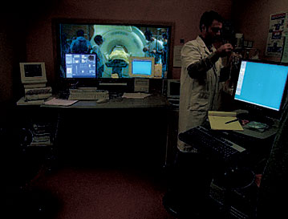
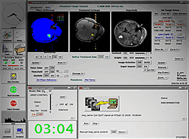
MRI UNIT
Laser Ablation Software provides real-time imaging of the procedure to the surgeon to measure temperatures.

Slide 13
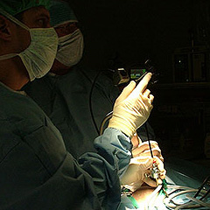
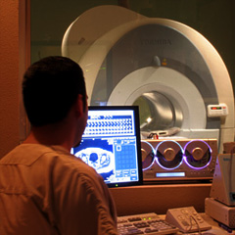
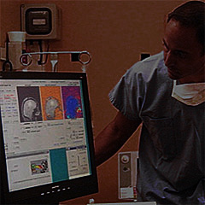
Image-guided Thermal Laser Ablation Technology in General Surgery / Soft Tissue
A Typical Liver Tumor Ablation Procedure
The MRI allows a physician to monitor treatment using special software to measure temperatures
Laser light heats and ablates tissue. Temperature maps show the physician the extent of the tissue being destroyed.
A small flexible laser probe is guided into the target area through a small incision in the skin.

Slide 14
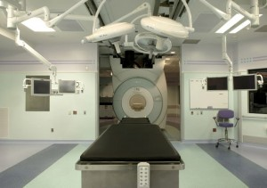
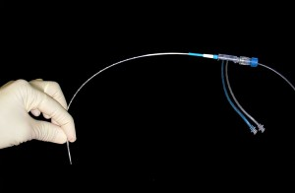
Image-guided Thermal Laser Ablation Technology in Urology
Ablation of tumors in the prostate.
Patient undergoes MRI scan of the prostate to identify individual tumor(s).
Often, a biopsy needle is placed into the tumor using minimally invasive techniques to confirm diagnosis.
The thin (1mm) laser probe is then placed into the tumor under MRI guidance using minimally invasive techniques.

Slide 15
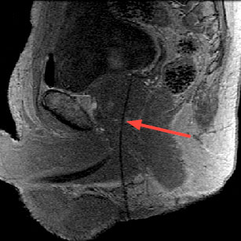
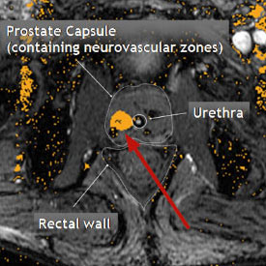
Pre-procedure MRI confirms placement of applicator in the target tissue.
The laser is activated to begin heating of the tumor. Using MR images and Visualase software allows the physician to see the tissue heating during laser irradiation, and control how much energy is delivered.

Slide 16
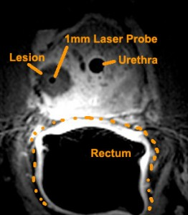
Results are confirmed with MR images.
The laser applicator is removed and the small incision is closed with one stitch and or a bandage. The entire procedure lasts approximately 1.5 to 3 hours, and often requires only mild conscious sedation or even just local anesthetic. Patient often returns home the same day with no catheter.

Slide 17
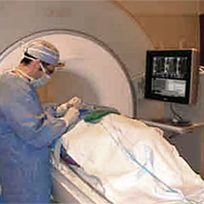
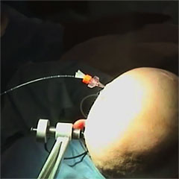
Image-guided Thermal Laser Ablation Technology in Neurosurgery
Surgery of brain tumors can be difficult and risky due to proximity to critical structures, and radiation therapy can damage healthy tissue. LITT is a new technology that might be of great benefit to those patients.
A small flexible laser probe is guided to the intended target area.
The MRI allows a physician to precisely monitor treatment using special software to measure temperatures.

Slide 18
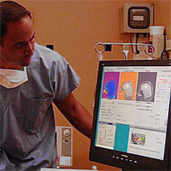
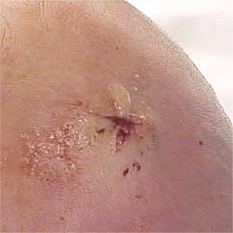
Laser light heats and destroys target area or tumor tissue. Temperature maps show the physician the extent of the tissue being destroyed, minimizing damage to healthy tissue.
The laser applicator is removed and the small incision is closed with one stitch and or a bandage.

